Slide 1

FACTORY ASSOCIATION
Application Guide
Dec 2023
© 2023 Vision Group

Slide 2
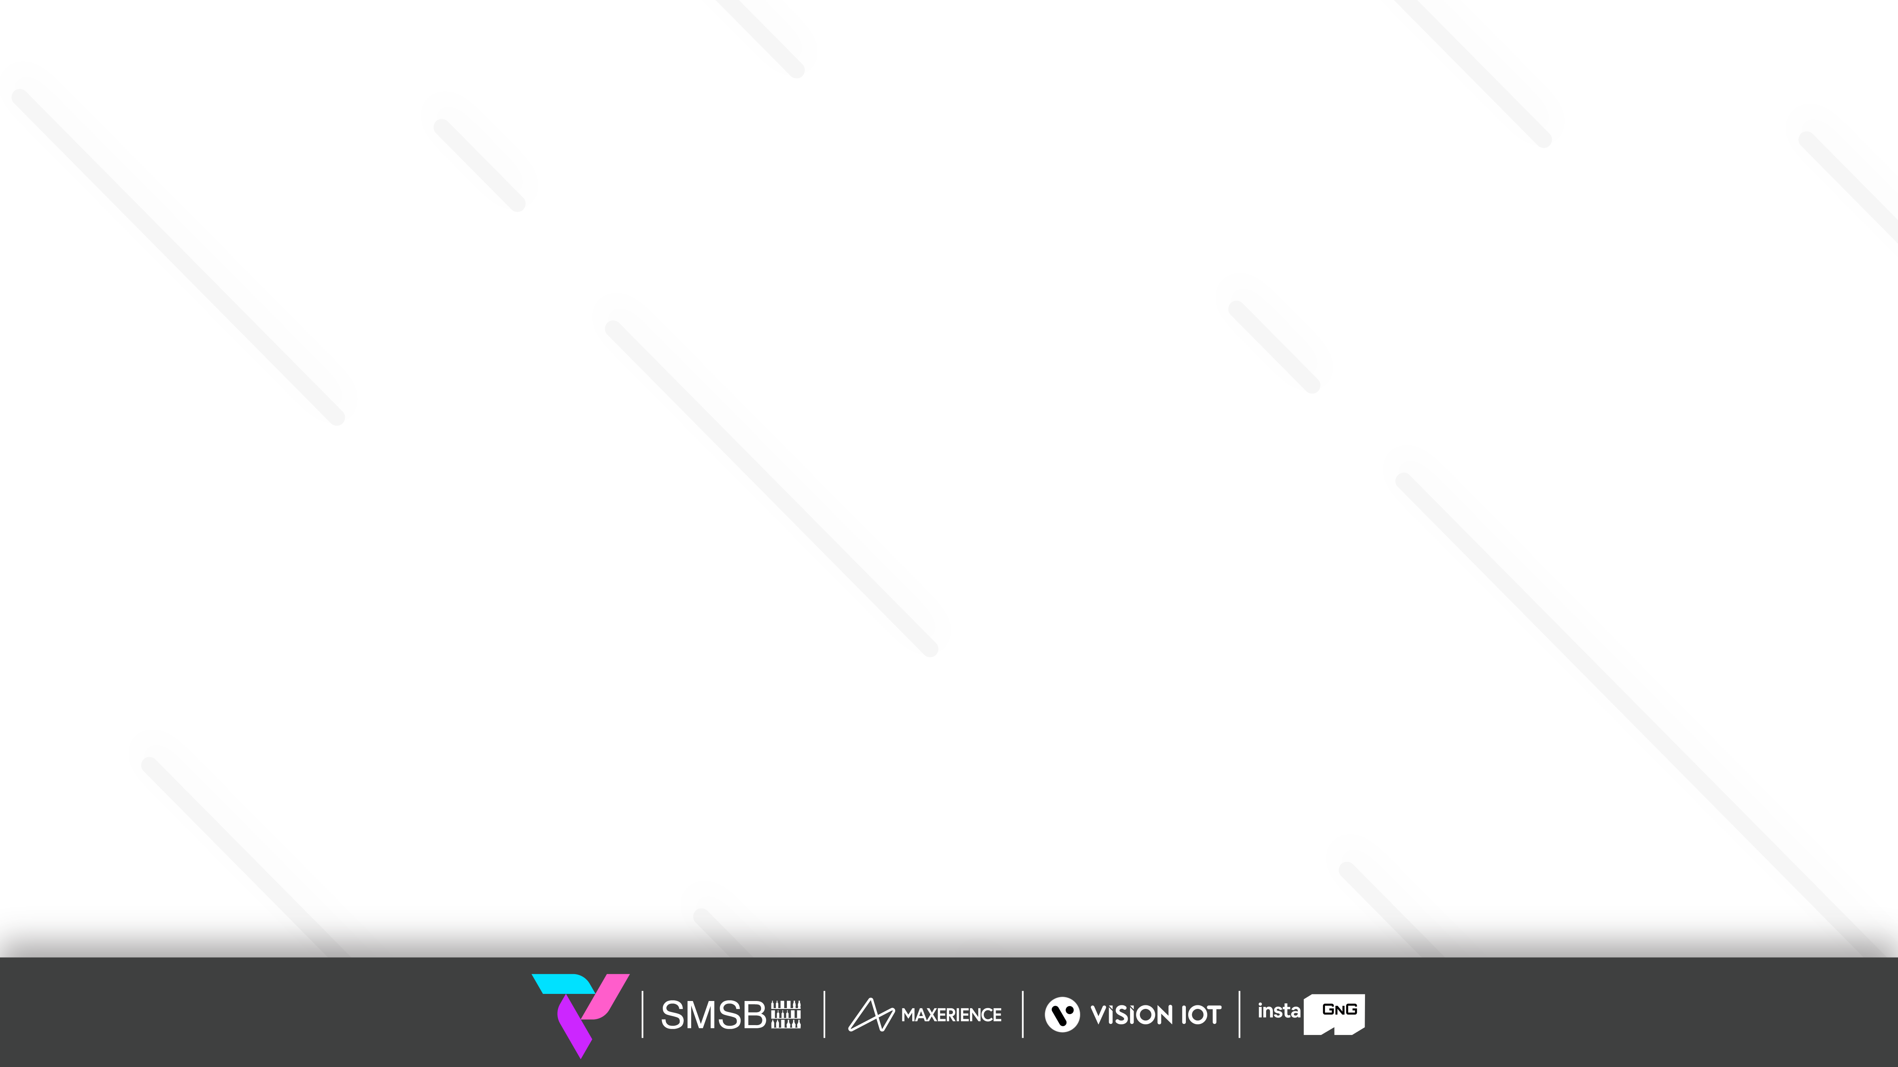
APPLICATION FEATURES
Association – To Associate the Smart Device with the Cooler in Factory.
Success Association Info – To Show the Successful Association Logs by Date with a message.
Failure Association Info – To Show the Failure Association Logs by Date with a message.
Association Overview – To summaries the Total Number of associations done.
© 2023 Vision Group

Slide 3
MINIMUM REQUIREMENTS FOR THE PHONES
Component | Minimum Required
Operating system | Android 9.0
Operating memory (RAM) | 4 GB and more
Free Storage | 4 GB
Camera | At least 5.0 MP with Autofocus
Processor (CPU) | A quad-core processor or faster
Bluetooth | BLE 4.2 and above
© 2023 Vision Group

Slide 4
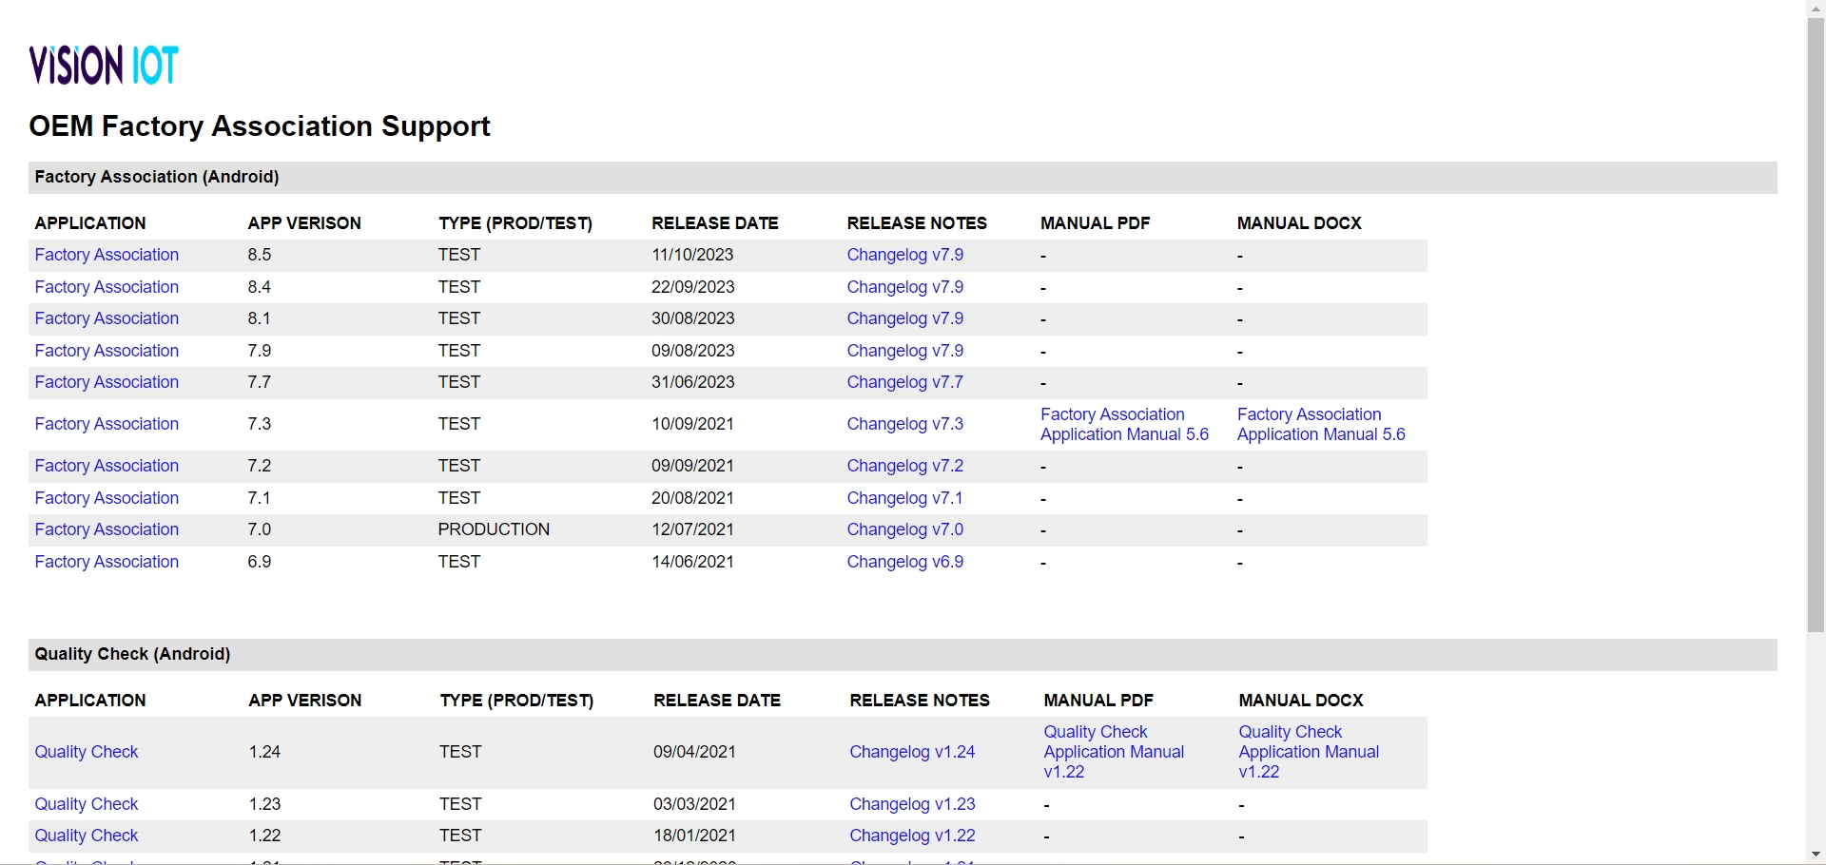
APPLICATION INSTALLATION
Install the “FACTORY ASSOCIATION” APK received from an Android phone link.
URL: https://apps.visioniot.net/downloads/Android/OEMFactory/
The Factory Association OEM application is compatible only with Smartphones having Android V9.0 and above.
Open VISION IOT’s Factory Association Application.
Log in to the application using the credentials provided by your administrator.
Suggested Note: Before installing every new version, Logout and delete the previous version.
Note: Please ensure Bluetooth, mobile Wi-Fi, or Mobile Data are ON in the device.
© 2023 Vision Group

Slide 5
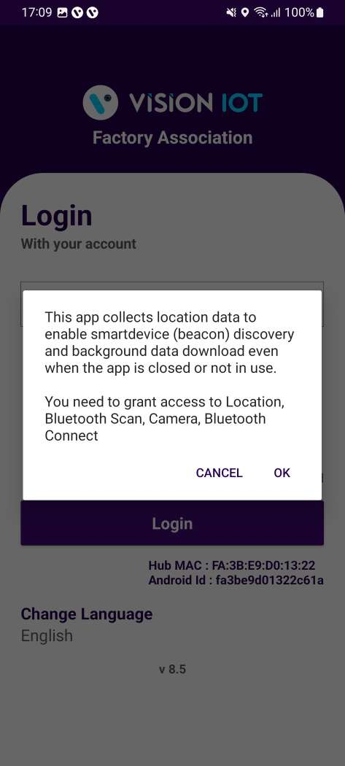
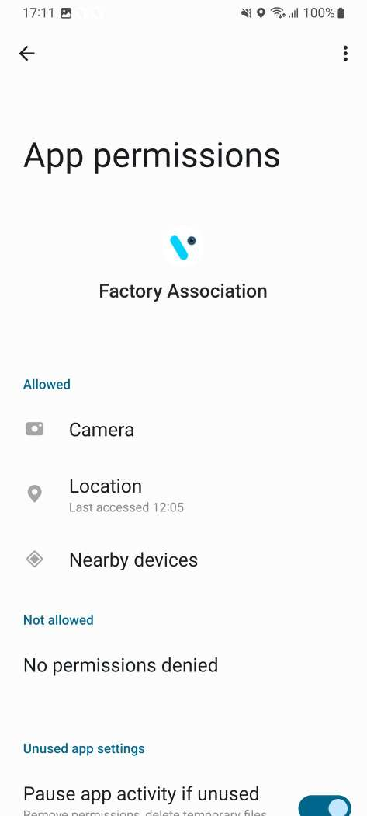
APPLICATION PERMISSION
After initial installation and launch, the Application will ask for permission to access.
Choose Server: For CCH and CCEP the user can use the OEM Factory Europe server.
Camera Permission, File and Media Permission, Location Permission, Nearby Device Permission Need to Allow.
PERMISSIONS
For Location (so beacons can be found) - Choose Allow While Using App on as per Handset OS.
Then Go to the Phone Settings > App Permissions > Location > Allow Location Access option is “Always”.
Same way Other Permissions like File and Media, Camera, Nearby Device need to Allow.
© 2023 Vision Group

Slide 6
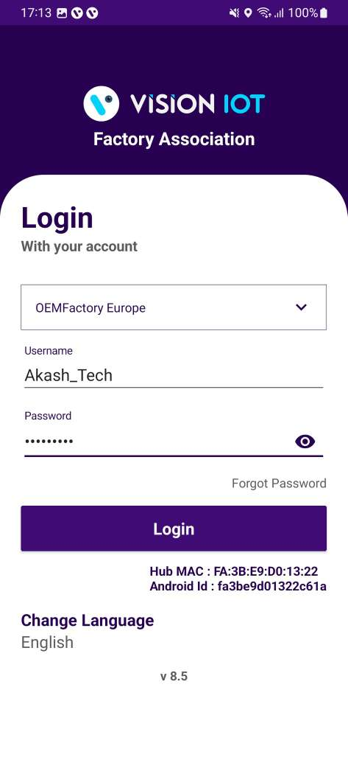
LOGIN
After installing the Factory Association OEM Application, open it and user will be redirected to the Login Page. Choose a server from the list and log in with valid credentials.
Please ensure that Bluetooth is turned on and that location services are enabled.
To log in, the application needs an active internet connection.
After logging in initially, the application can be used in offline mode as long as the same username and password used for the online login are used.
Devices must have at least 4GB of RAM and Bluetooth version 4.2 or higher.
The minimum required operating system version is 9.0 or above.
© 2023 Vision Group

Slide 7
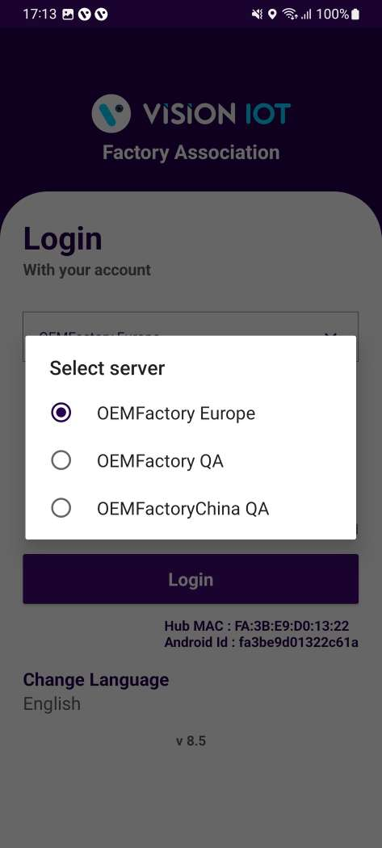
Default OEM Factory Europe Server shows, depending on the Client and Factory user should choose a different option,
  For CCH and CCEP the user can use the OEM Factory Europe server.
To change the language, tap on Change Language and use can choose the language. Currently, there is English language support available.
Depending on the Android Version user may get several different prompts to confirm access to the camera, Bluetooth (location services), Storage, etc.
© 2023 Vision Group

Slide 8
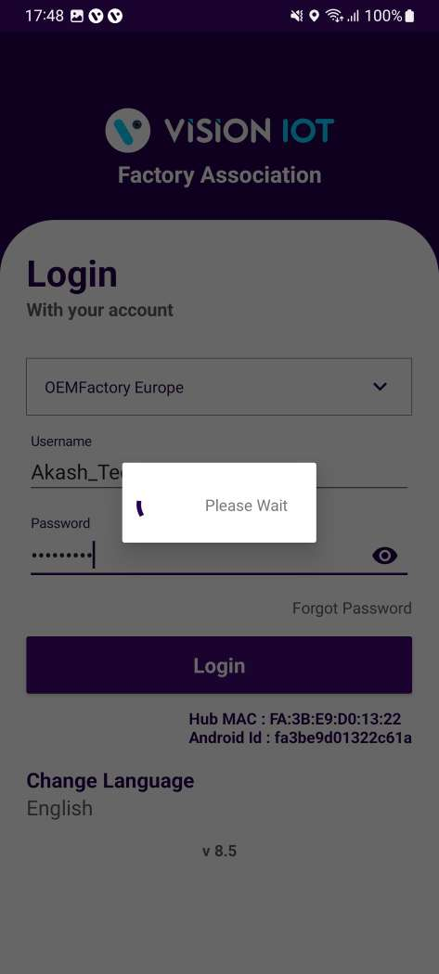
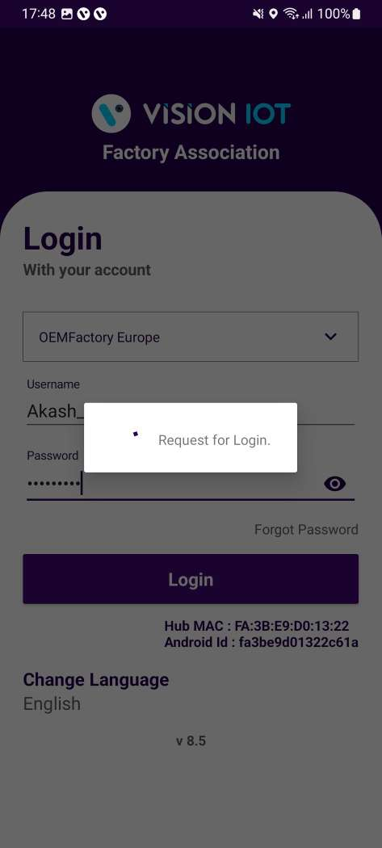
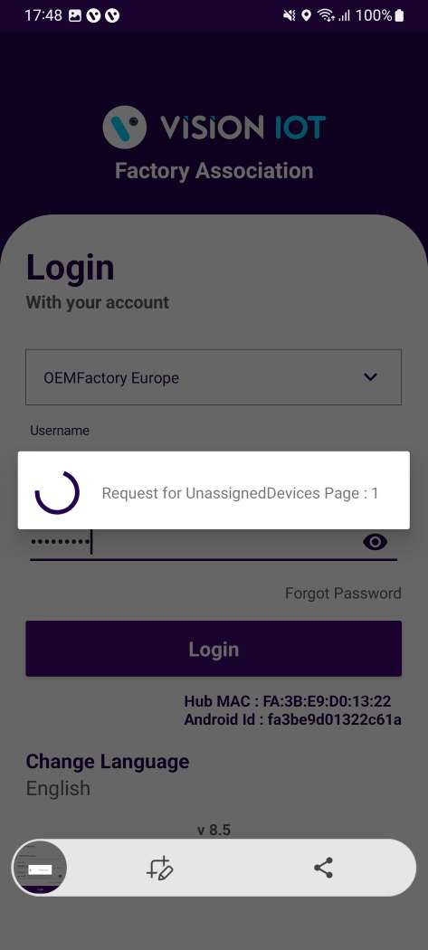
Provide valid credentials and tap on the Login button, please be advised that the application will need some time to download data from the cloud.
Note: Internet connectivity is required during login otherwise login will fail, and the application will not work.
© 2023 Vision Group

Slide 9
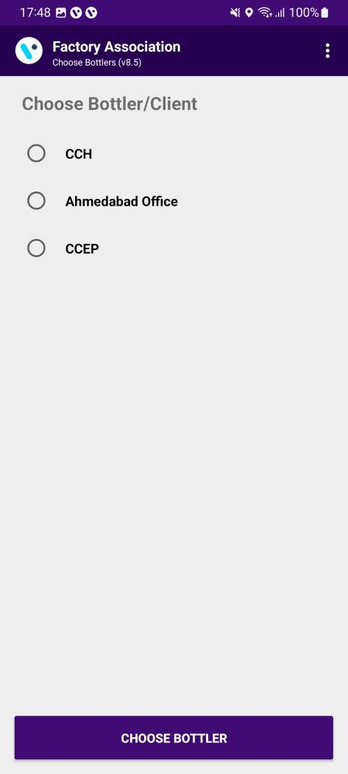
ASSOCIATION – SELECT BOTTLER/CLIENT
Users must choose the bottler/client whom they are doing the smart device association for.
© 2023 Vision Group

Slide 10
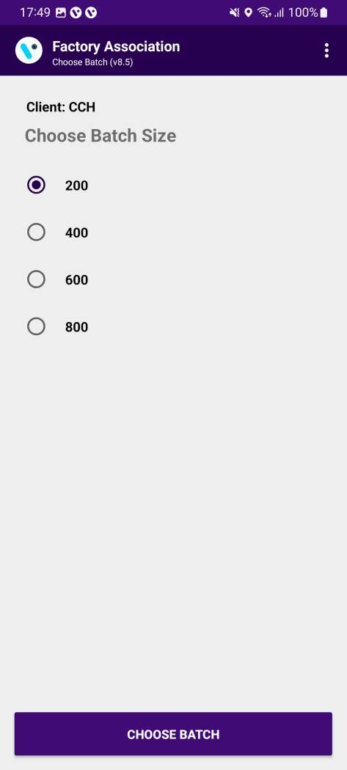
ASSOCIATION – CHOOSE BATCH SIZE
Once the client selection is done, the user must choose the pool batch size to initiate device association for that client.
© 2023 Vision Group

Slide 11
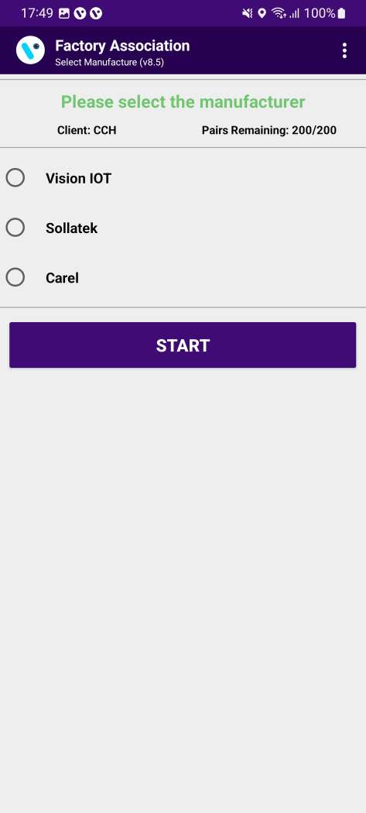
ASSOCIATION – SELECT THE MANUFACTURE
Users must choose the cooler manufacturer as per the smart device type.
  For VISION IOT Devices Select Vision IOT.
  For Sollatek Devices Select Sollatek.
  For Carel Devices Select Carel.
© 2023 Vision Group

Slide 12
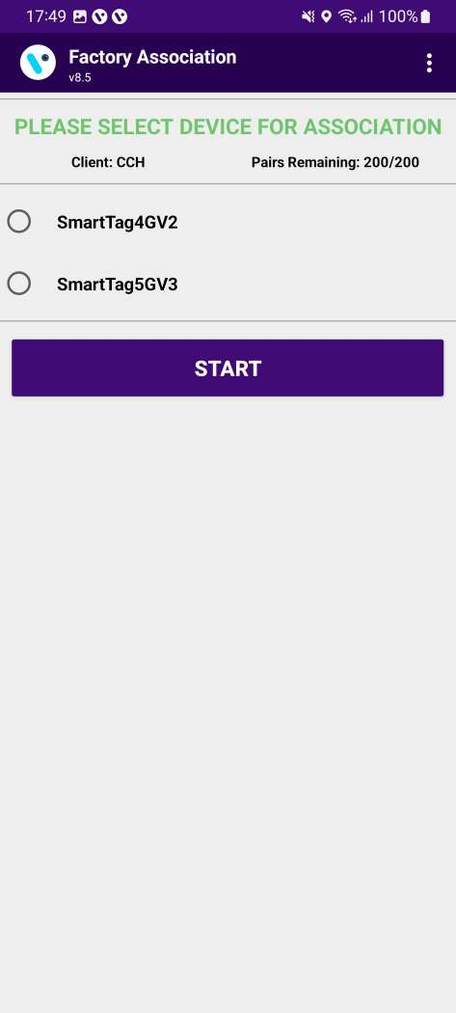
ASSOCIATION – SELECT SMART DEVICE TYPE
Select the Smart Device Type for which the user needs to do association. Association-supported smart device list showing in the display.
Users must choose here smart device type from the list for which users want to do association.
  If a SmartTag5GV3 will be associated, please choose SMART TAG5GV3 and click on the START button.
© 2023 Vision Group

Slide 13
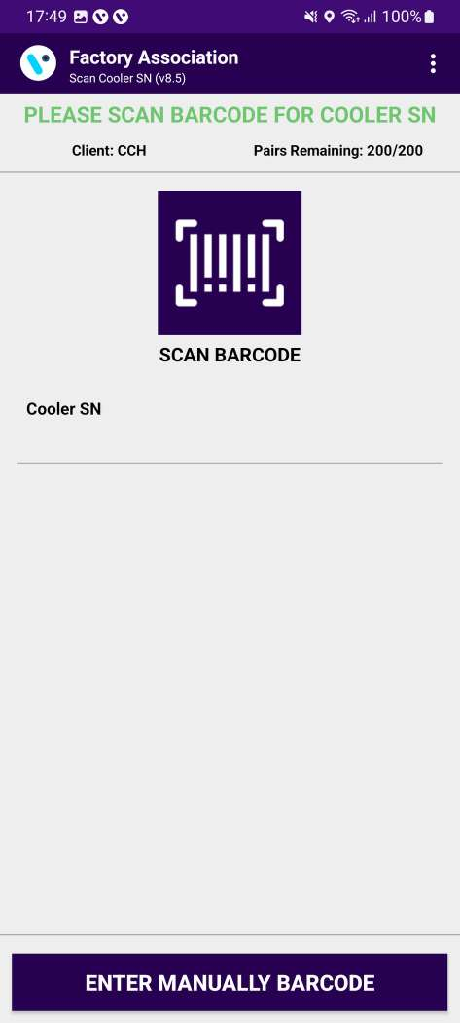
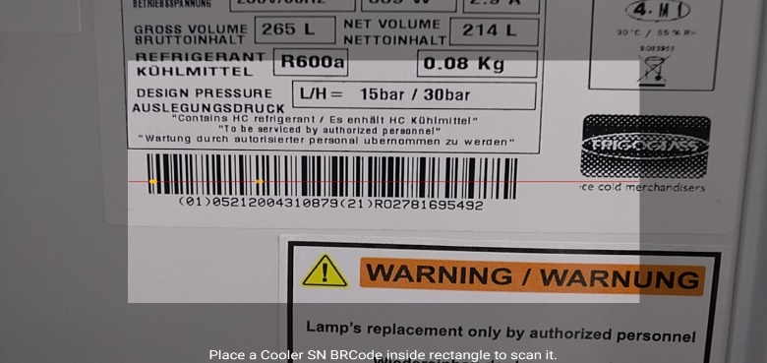
ASSOCIATION – SCAN COOLER SN
Tap on SCAN BARCODE and scan the barcode of the cooler. Cooler Serial Numbers could also be entered manually by taping on “ENTER MANUALLY BARCODE”.
© 2023 Vision Group

Slide 14
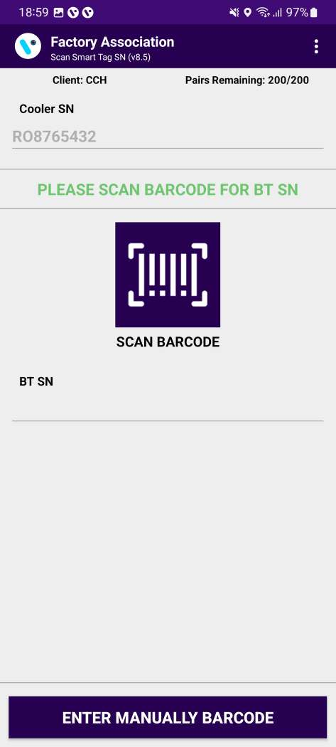
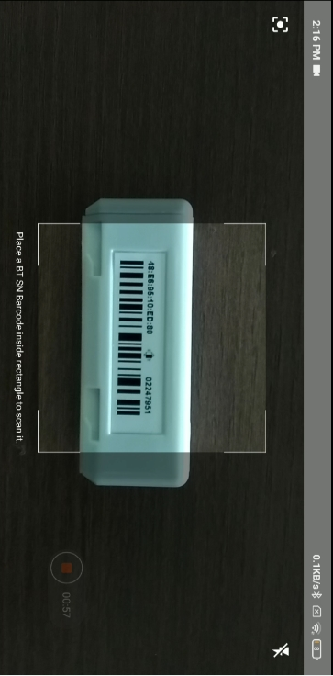
ASSOCIATION – SCAN SMART DEVICE SN
After the barcode of the cooler is successfully scanned open and close the door of the cooler to wake up the SmartTag and tap again on SCAN BARCODE for Smart Device Serial and scan the barcode of the SmartTag. Smart Device Serial Number could also be entered manually by taping on “ENTER MANUALLY BARCODE”.
© 2023 Vision Group

Slide 15
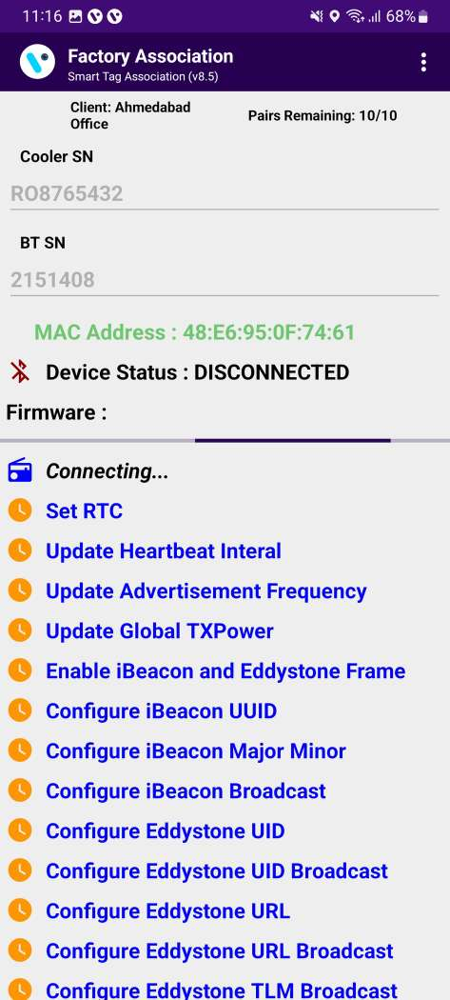
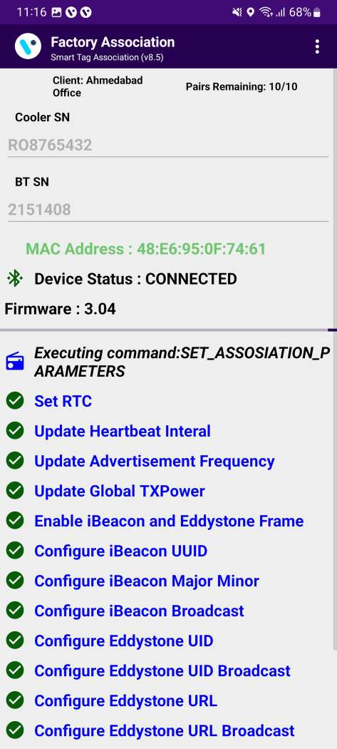
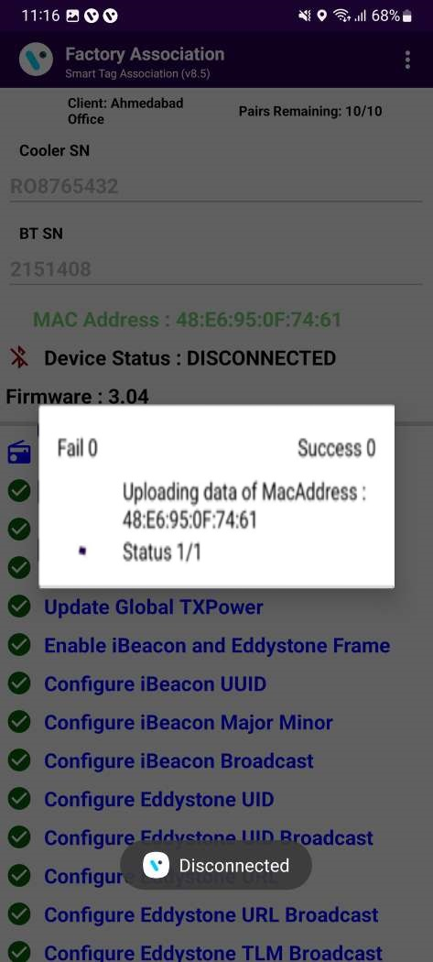
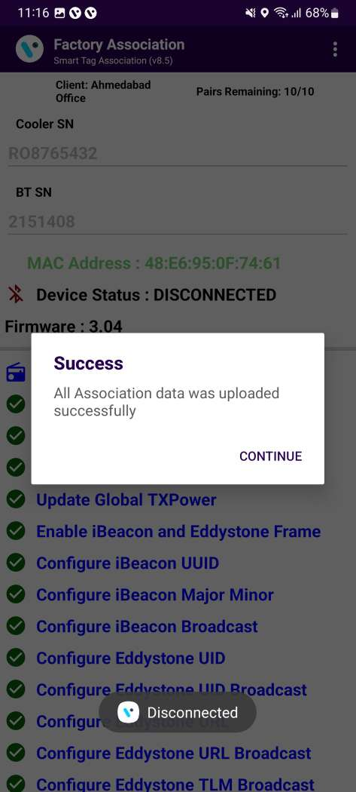
ASSOCIATION – SMART DEVICE CONFIGURATION SETTING UP
After the SmartTag Serial Number is successfully scanned the following screen will be shown. It will initialize the association process and respectively show the SUCCESS message.
If the Scanning Timer reaches 30 seconds open and close the door again, if this doesn’t help check if the SmartTag and the Magnet are installed correctly. The Cooler Serial Number and Smart Device Serial Number can be seen on the screen.
© 2023 Vision Group

Slide 16
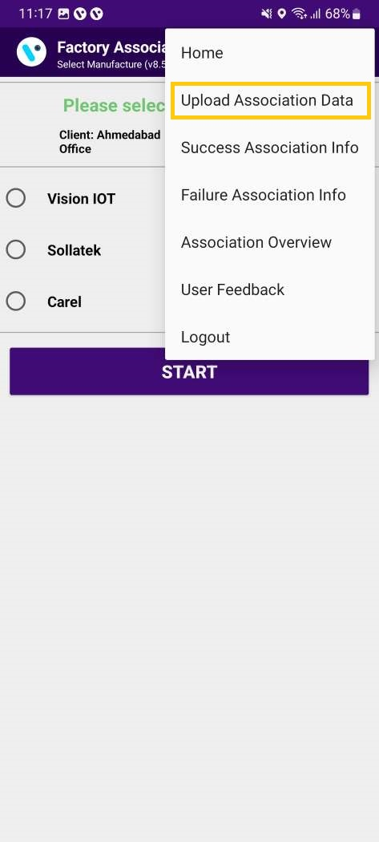
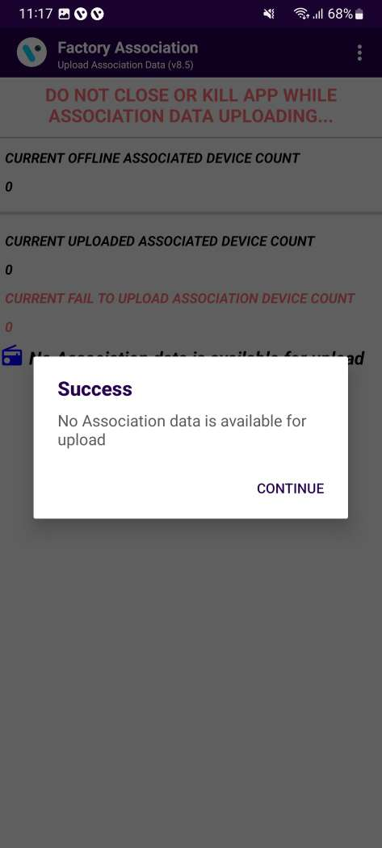
LOGS – UPLOAD ASSOCIATION DATA
To check if all the associated data is uploaded, tap on the hamburger menu in the upper right corner and then tap on Upload Association Data. Once data is uploaded a prompt saying all Association data uploaded was successful. If there is no data for upload a prompt saying that will be shown.
© 2023 Vision Group

Slide 17
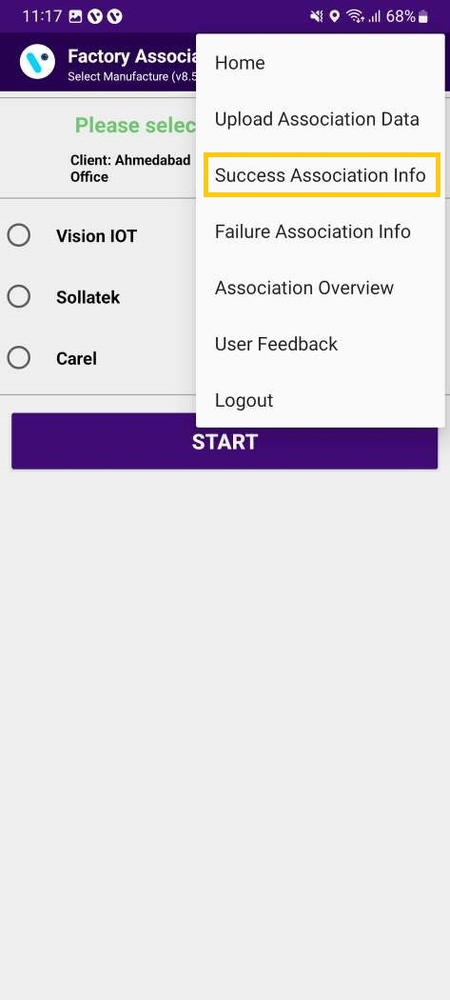
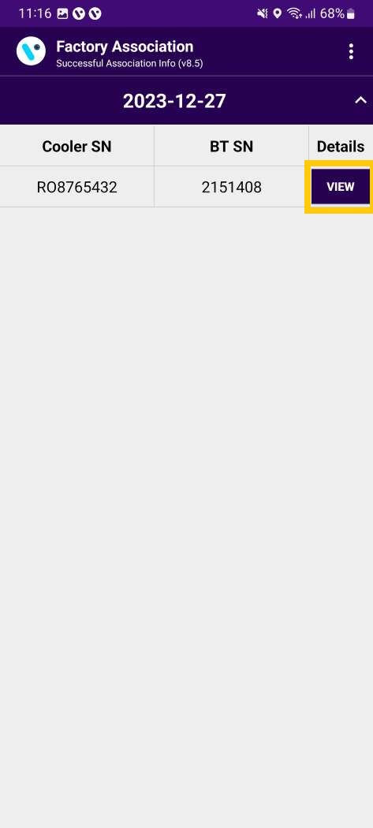
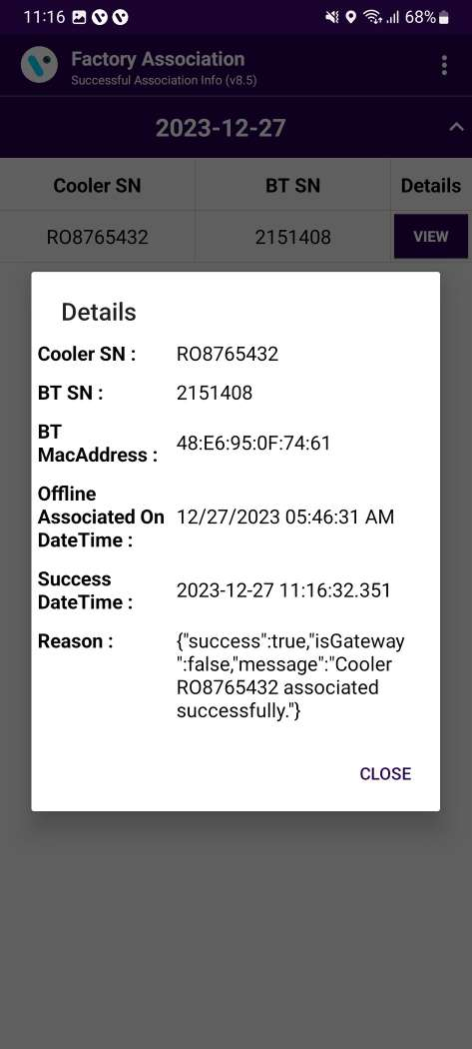
LOGS – SUCCESS ASSOCIATION INFO
To check all Successful Associations Info, tap on the hamburger menu in the upper right corner and then tap on Success Association Info and view the button showing details of the association.
© 2023 Vision Group

Slide 18
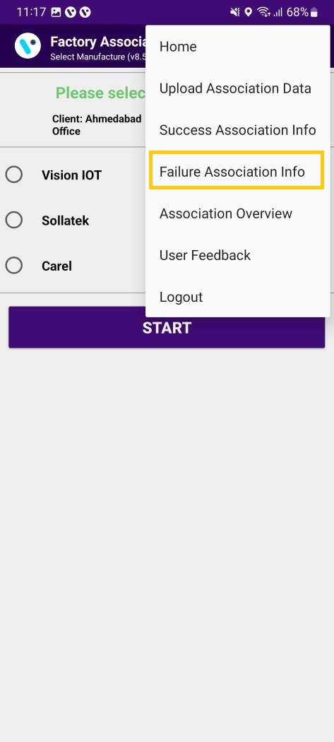
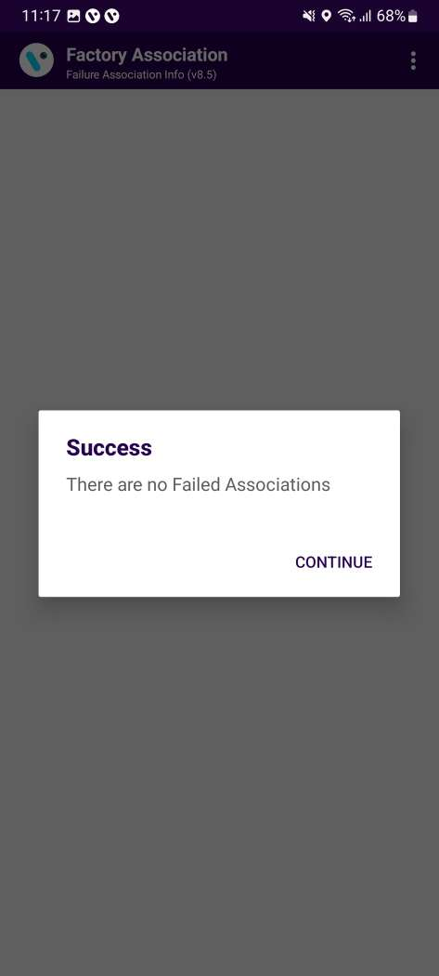
LOGS – FAILURE ASSOCIATION INFO
To check all Failed Associations Info, tap on the hamburger menu in the upper right corner and then tap on Failure Association Info.
© 2023 Vision Group

Slide 19

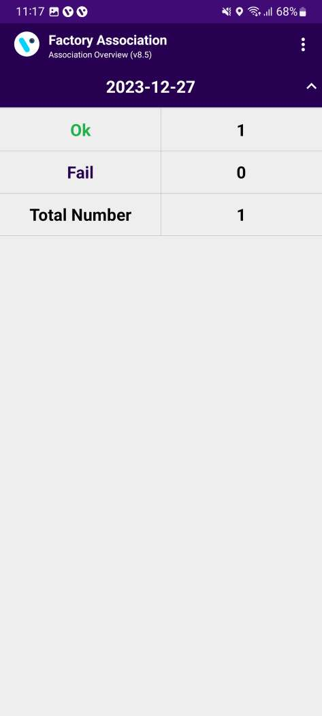
LOGS – ASSOCIATION OVERVIEW
To check the Associations Overview, tap on the hamburger menu in the upper right corner and then tap on Association Overview.
© 2023 Vision Group

Slide 20
MESSAGES – OK/Success Messages
Detailed Message | Short Message | User Story
No Association Data Is Available For Upload | OK | Shown when there is no data for upload.
All Association Data Was Uploaded Successfully | OK | Shown when all association data is uploaded.
There Are No Failed Associations | OK | Shown on the failure association info screen when there are no associations that have failed.
Smart Device <SD SN> Is Associated Successfully To Cooler <Cooler SN> | OK | Shown after successful association.
© 2023 Vision Group

Slide 21
MESSAGES – ALERTS Messages
Detailed Message | Short Message | User Story
You Must Upload Association Data In Order To Logout | Alert 50 | Shown when the user presses logout but offline associated data is available.
Do You Want To Upload Association Data To Avoid Missing Data? | Alert 51 | Shown on the device selection screen when offline associated data is available.
Please Select What Smart Device You Want To Associate | Alert 52 | Shown on the device selection screen when the user does not select any device option for the association.
No Associations Were Uploaded | Alert 53 | Shown on successful association info when no successful info is there.
Cooler Serial Number Is Not Scanned | Alert 54 | Shown on the cooler SN screen when the user canceled the barcode reading.
Smart Device Serial Number Is Not Scanned | Alert 55 | Shown on the smart device SN screen when the user canceled the barcode reading.
You Must Upload Association Data | Alert 56 | Shown on the device selection screen when offline data is available.
© 2023 Vision Group

Slide 22
MESSAGES – ERROR Messages
Detailed Message | Short Message | User Story
The Barcode Scanner Is Not Supported | ERROR 50 | Shown on scan cooler SN and scan smart device SN screen if the cell phone does not support the barcode scanner.
Smart Device Is Not Available For Association | ERROR 51 | Shown on scan smart device SN screen when smart device not found in unassigned list.
Smart Device Is Already Associated | ERROR 52 | Shown on the scan smart device SN screen if the smart device is already associated.
Smart Device Serial Number Is Not Valid | ERROR 53 | Shown on the scan smart device SN screen if the smart device SN is not valid.
Cooler Serial Number Was Not Scanned | ERROR 54 | Shown on scan cooler SN when the user cancels the barcode scanning or any issue while barcode scanning arises.
Cooler Has Another Device Associated To It | ERROR 55 | Shown on the scan cooler SN screen if the cooler has a smart device already associated with it.
Please Enter Cooler Serial Number | ERROR 56 | Shown on the scan cooler SN screen when in manual mode for cooler SN and the user presses the save button without entering the cooler SN.
Please Enter Smart Device Serial Number | ERROR 57 | Shown on the scan smart device SN screen when in manual mode for smart device SN and the user presses the save button without entering the smart device SN.
Smart Device Configuration Failed, Please Try Again | ERROR 58 | Shown on the association screen when a command fails.
Smart Device Configuration File Missing | ERROR 59 | Shown on the association screen when configuration JSON missing for the smart device.
Not All Association Data Was Uploaded Successfully | ERROR 60 | Shown when some associations failed to be uploaded.
© 2023 Vision Group

Slide 23
Detailed Message | Short Message | User Story
Smart Device not found, please try to wake up the Smart Device and try again | ERROR 61 | Shown on the Association screen when the application is not able to connect to the Smart Device.
Session expired, please check your internet connection and login again | ERROR 62 | Shown when User Session expired (Token expired) on the server.
Please check your internet connection and try again | ERROR 63 | Shown when Wi-Fi and mobile data off and the user calls the API.
Cannot connect to the Smart Device, please change the Smart Device | ERROR 64 | Shown on the Association screen when smart device connection is not working (when the device was found but did not connect to the phone after the 2nd retry).
Cannot connect to the server, please try again | ERROR 65 | Shown on Login and Upload Association Data screen when API calling in between timeout happen or any server connection error.
Cooler Serial Number is not valid | ERROR 66 | Shown on Cooler SN Screen when the cooler serial number is not valid.
Invalid response from the server | ERROR 67 | Shown on Uploading association when the server gives the invalid response.
Device is not connected, please connect again | ERROR 68 | Shown on the association screen when we are trying to execute the command and the device is not connected.
Device Configuration not available | ERROR 69 | Shown when Smart Device Type Configuration is not found for the particular device.
© 2023 Vision Group

Slide 24
Thank You!
© 2023 Vision Group

